Slide 1

Pets make your life happier

Slide 2
What pet do you like to keep? Why?
/01

Slide 3
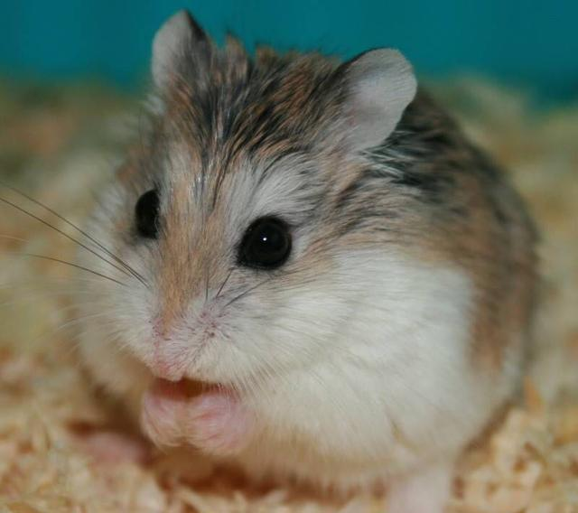
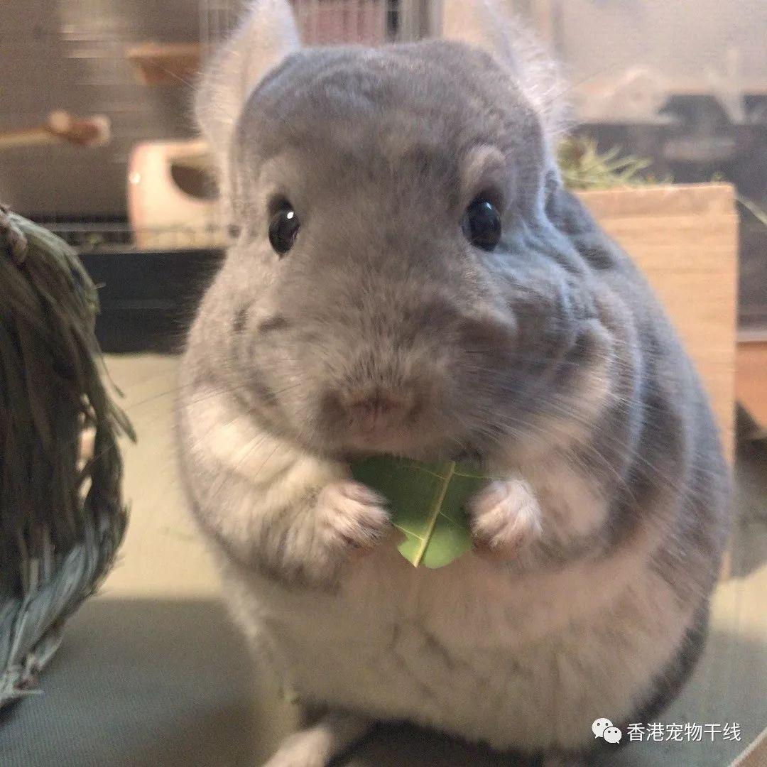
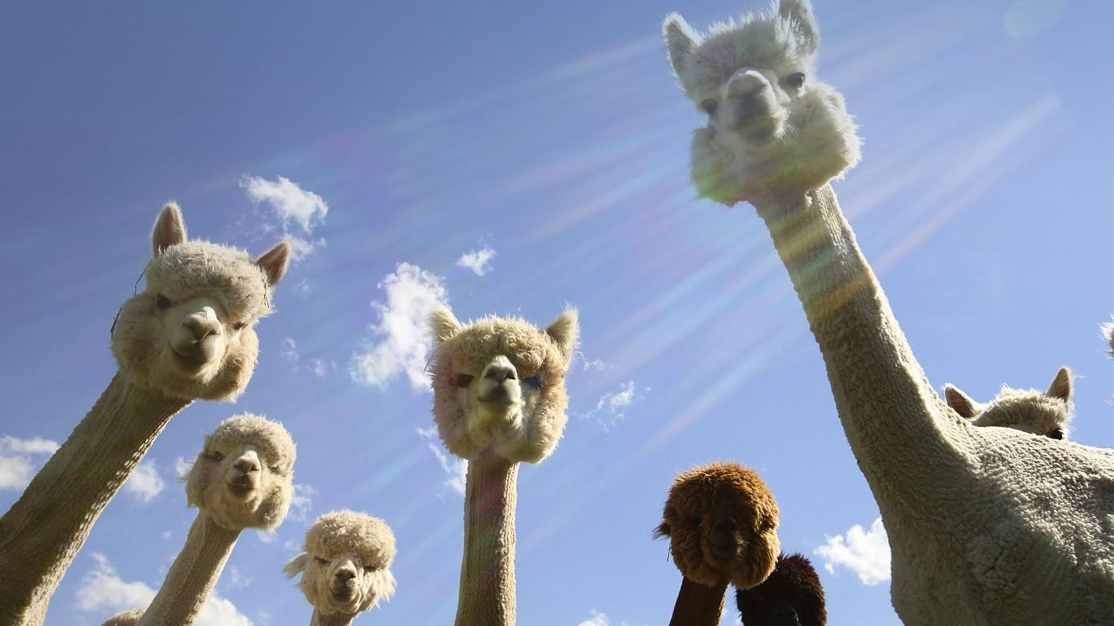
What pet do you like to keep?
Dog
2. Cat
3. Hamster
4. Chinchilla
5. Rabbit
6. Fish
7. Turtle
8. Alpaca
9. Fragrance pig

Slide 4
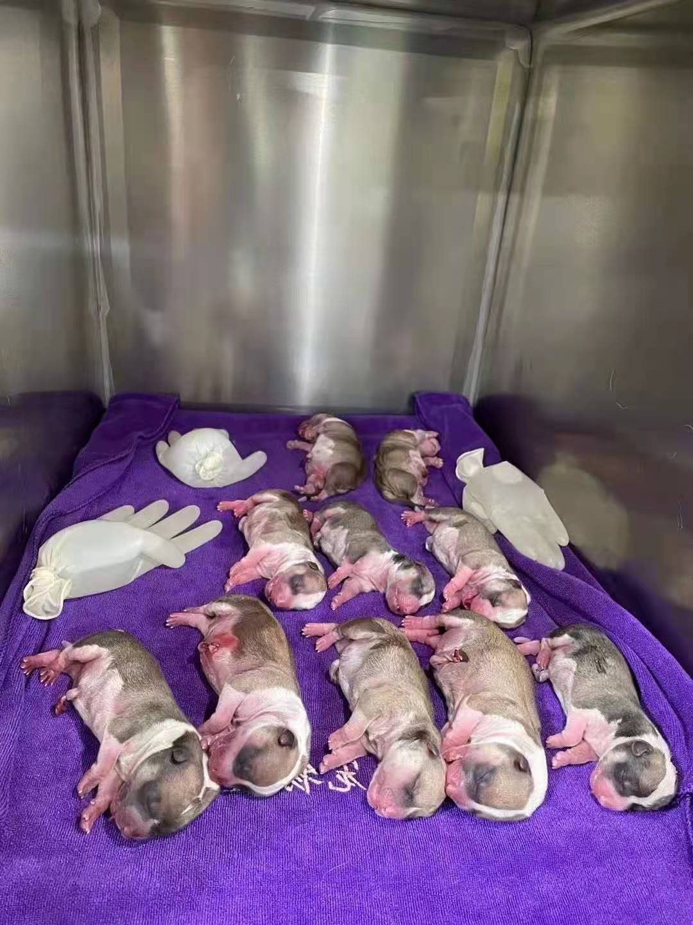
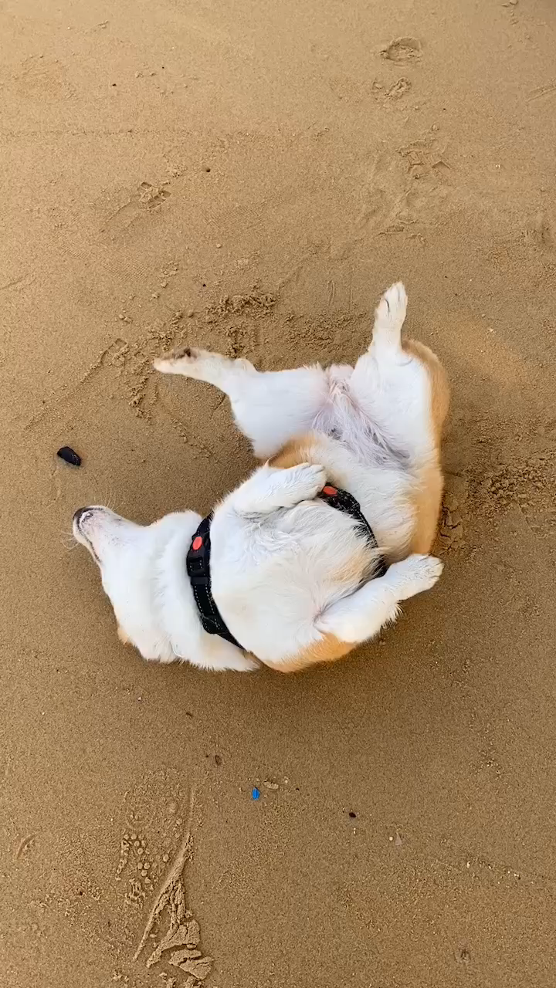
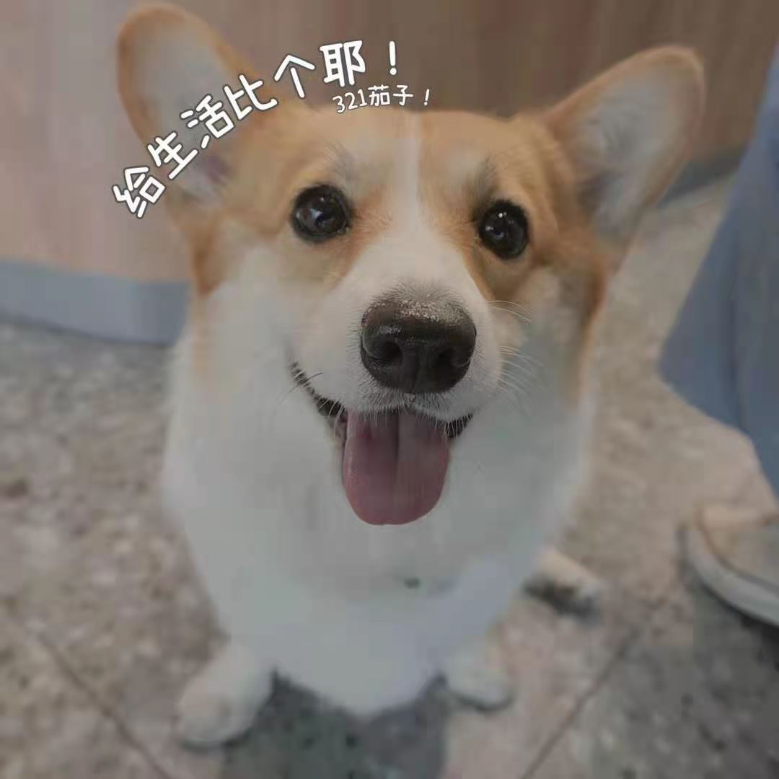
My friend’s pet
Welsh corgi Pembroke(Big ass dog)

Slide 5
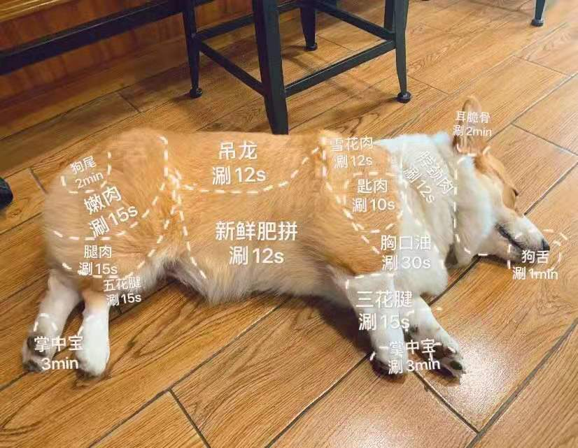
My friend’s pet

Slide 6
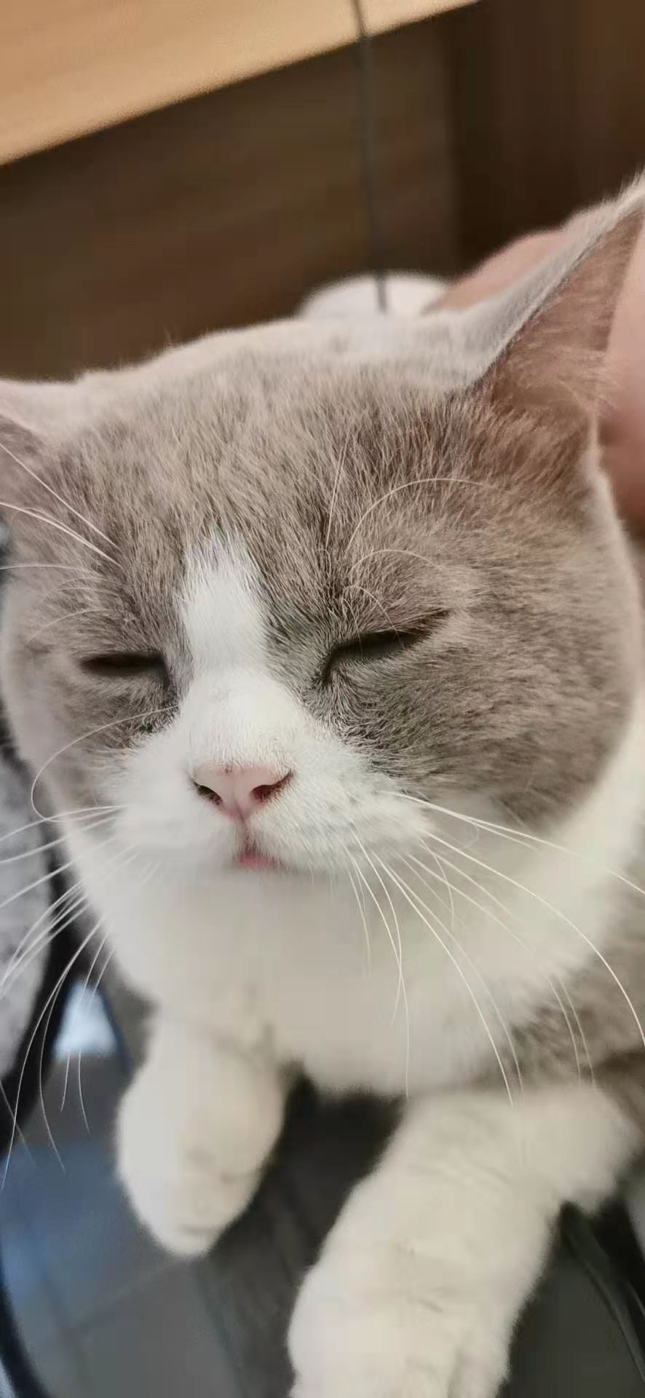
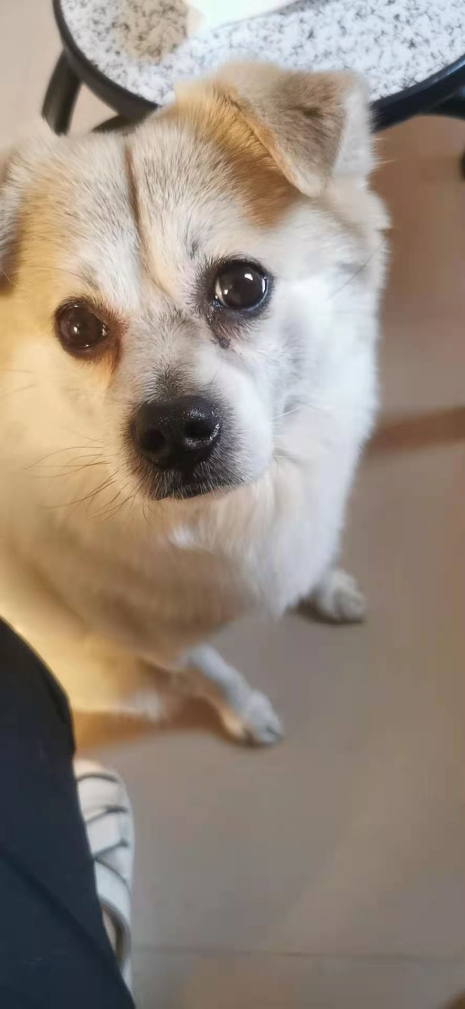
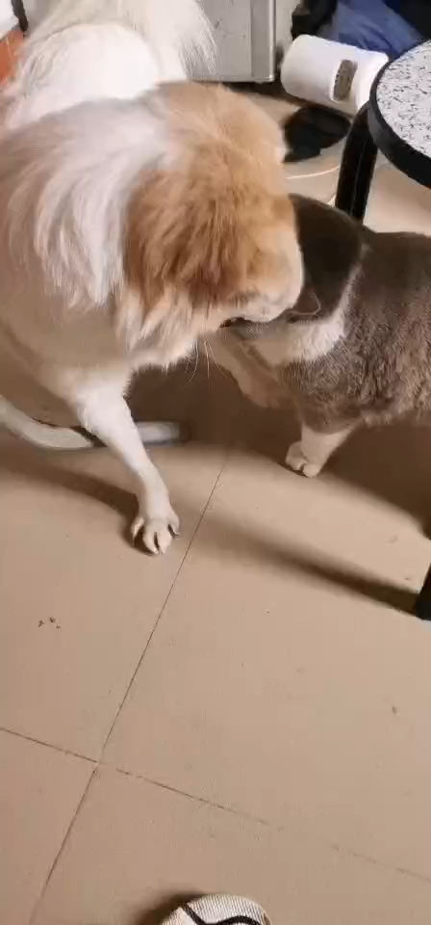
My friend’s pet
British shorthair cat(英短)
Chinese rural dog

Slide 7
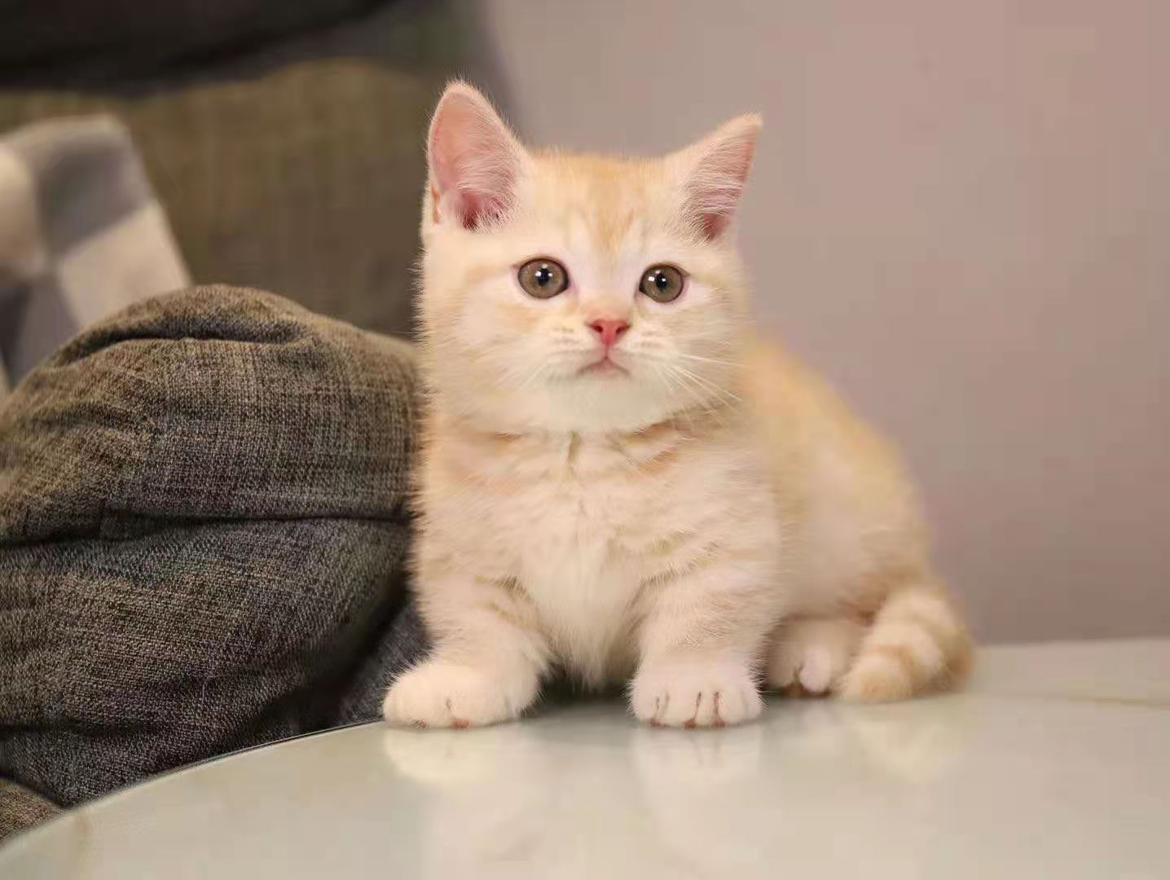
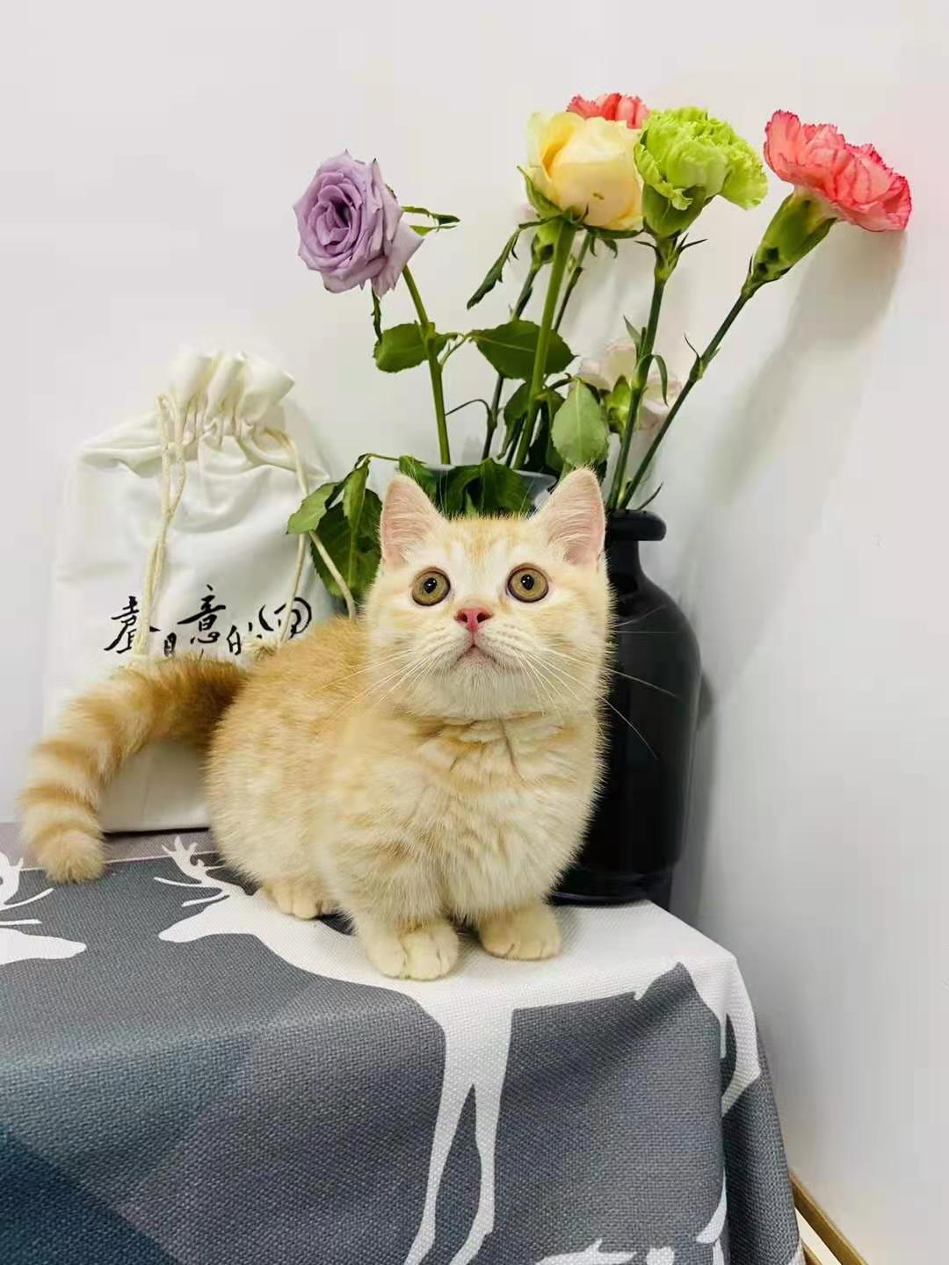
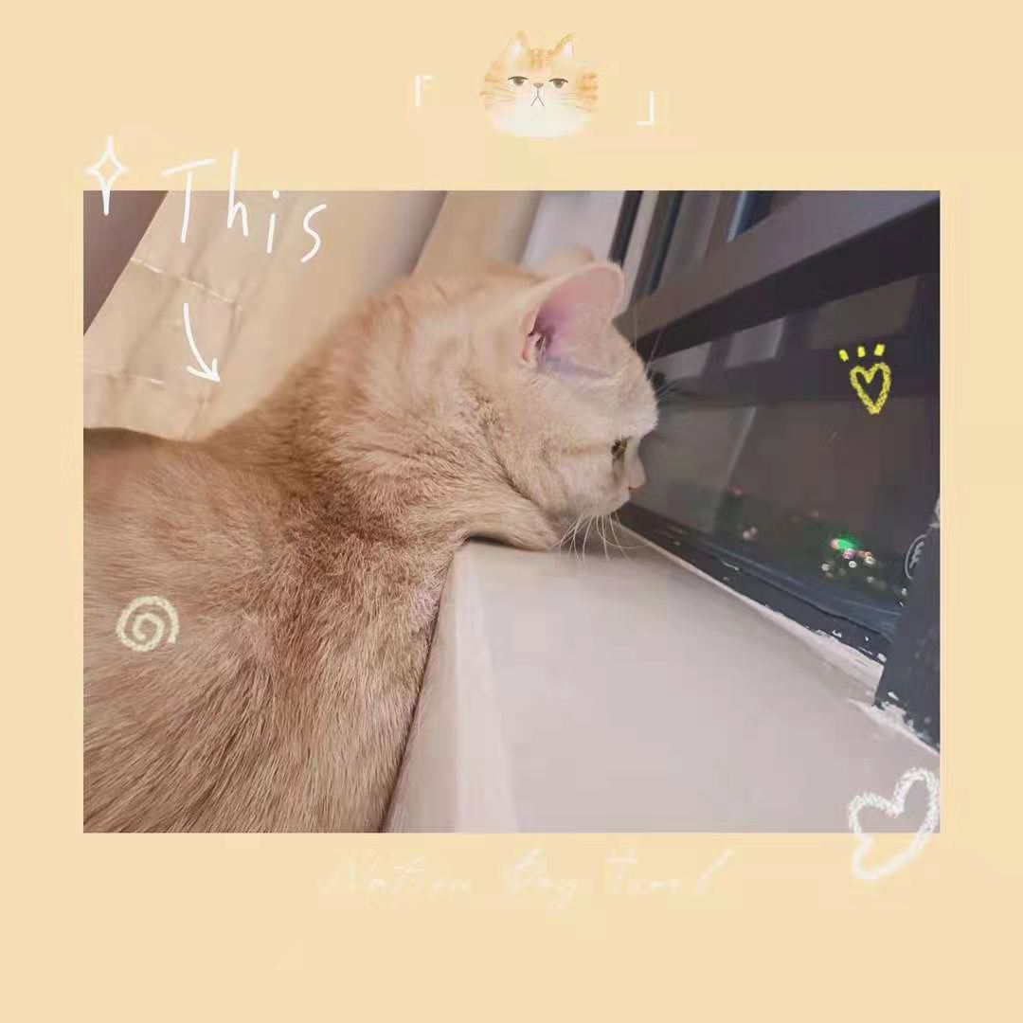
My friend’s pet
Munchkin cats(曼康基矮脚猫)

Slide 8
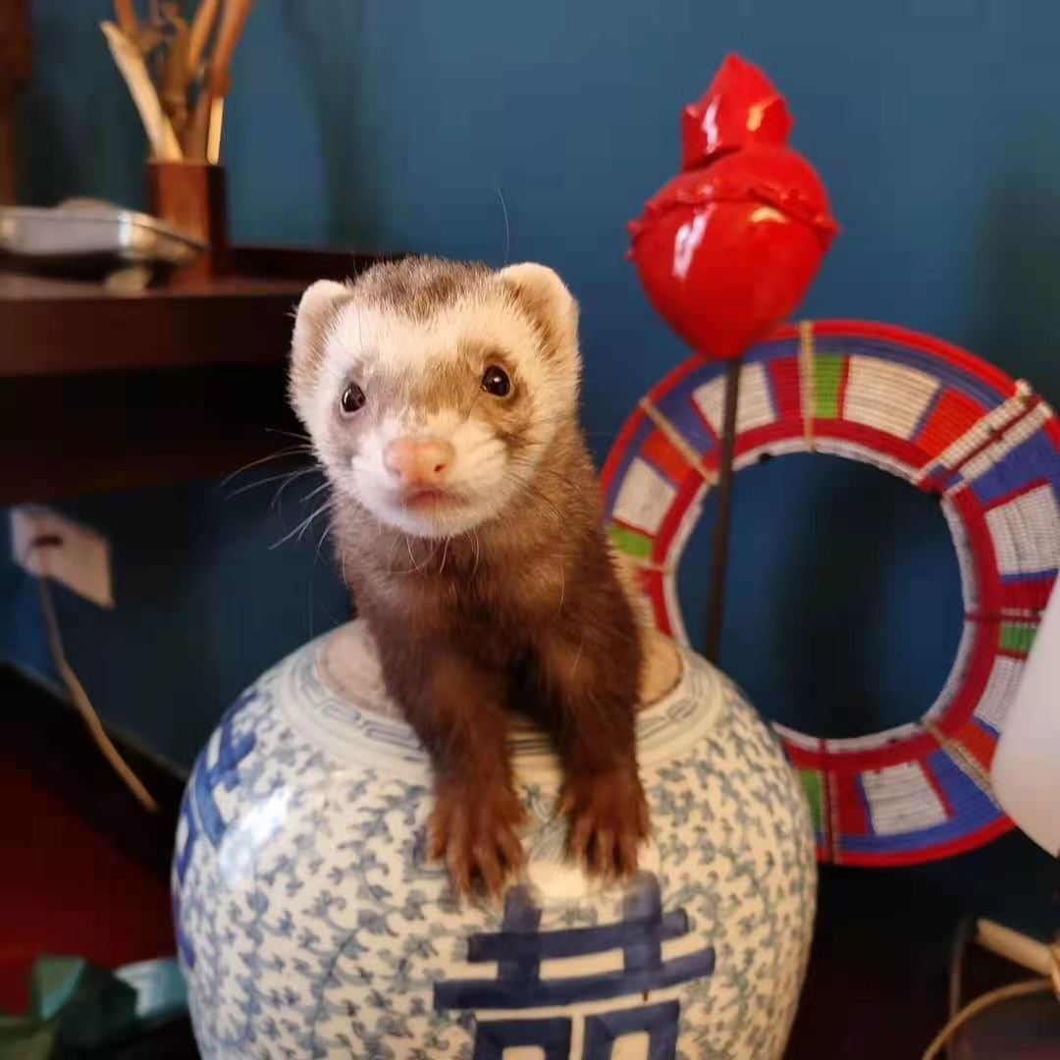
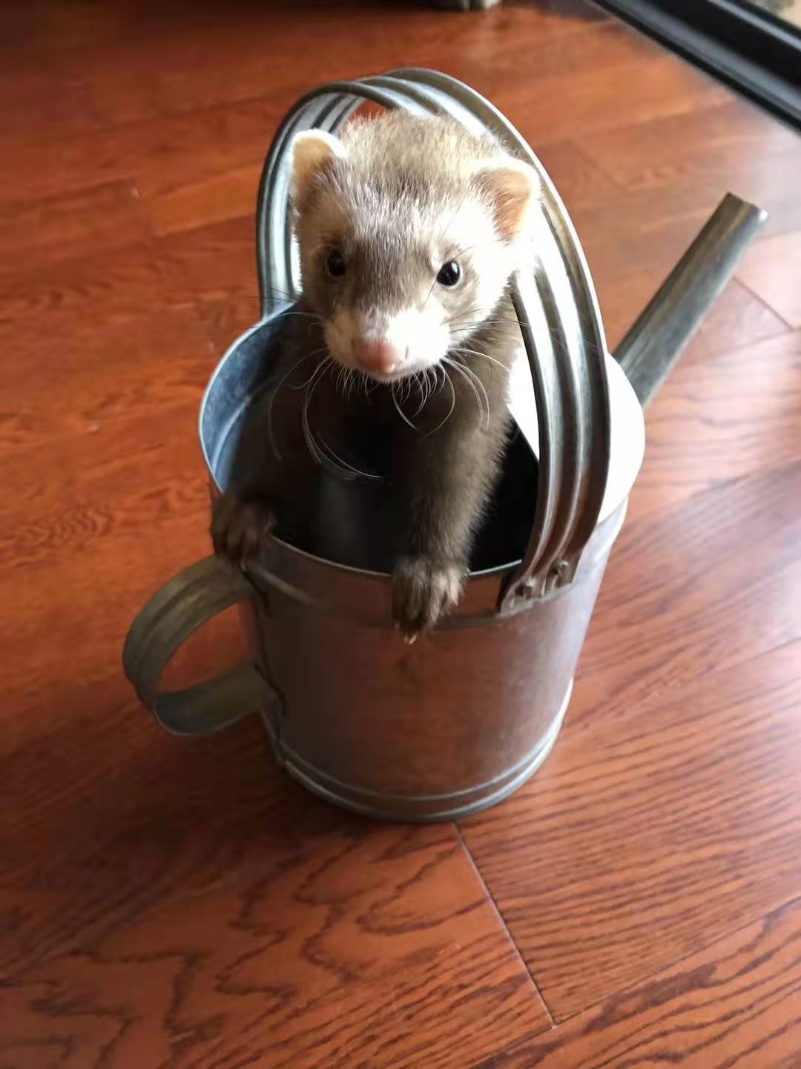
My friend’s pet
Ferret (貂)
Ferret has become the third largest pet among dogs and cats

Slide 9
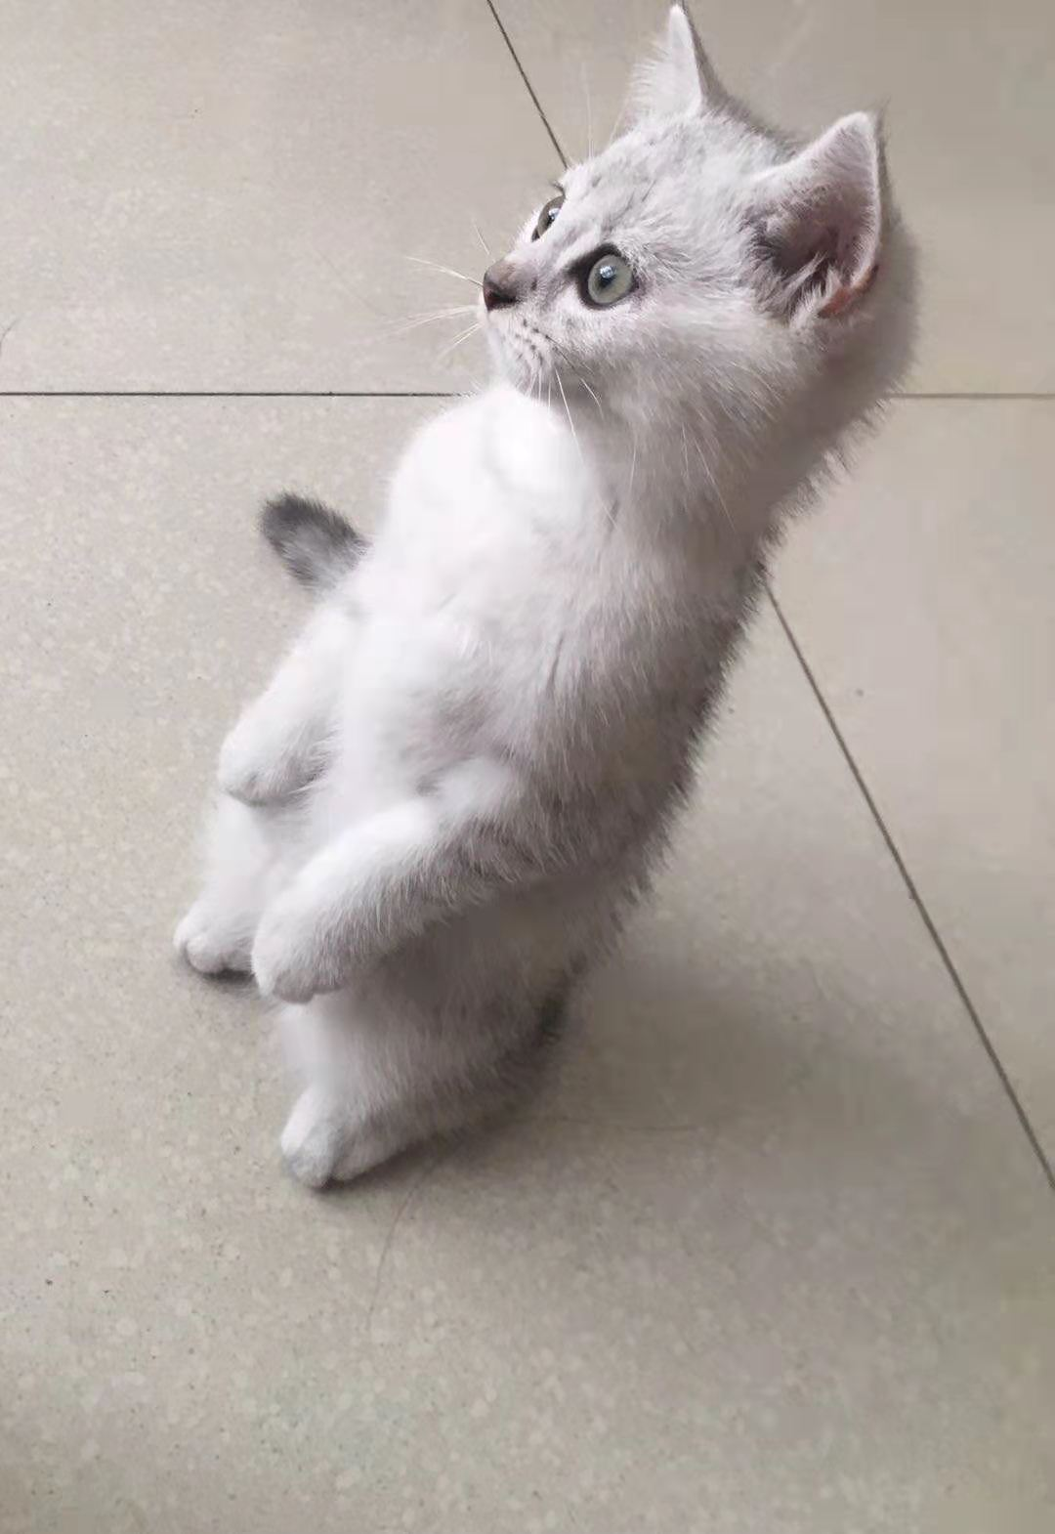
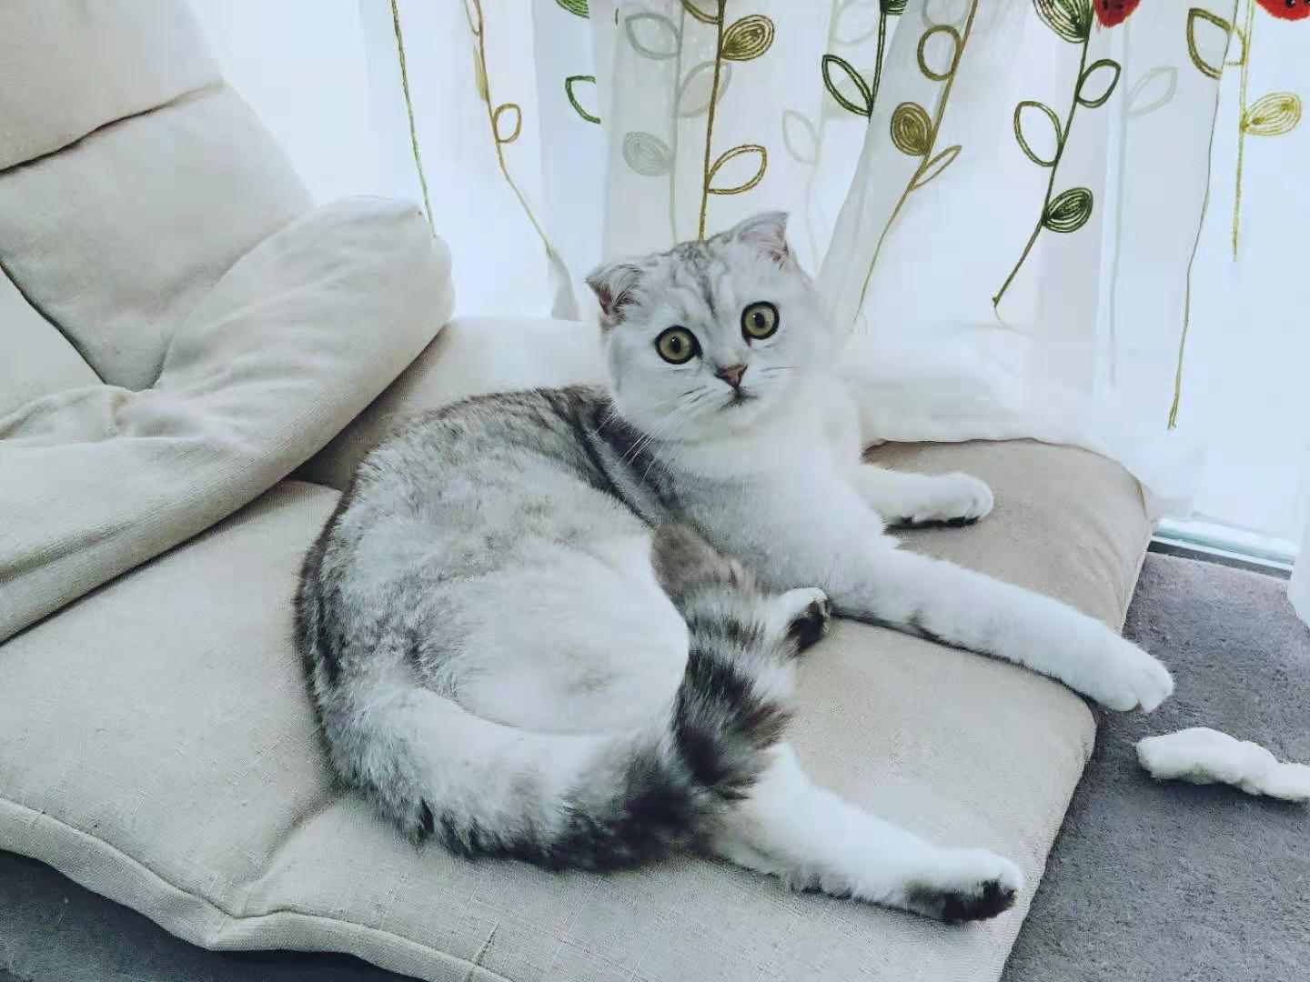
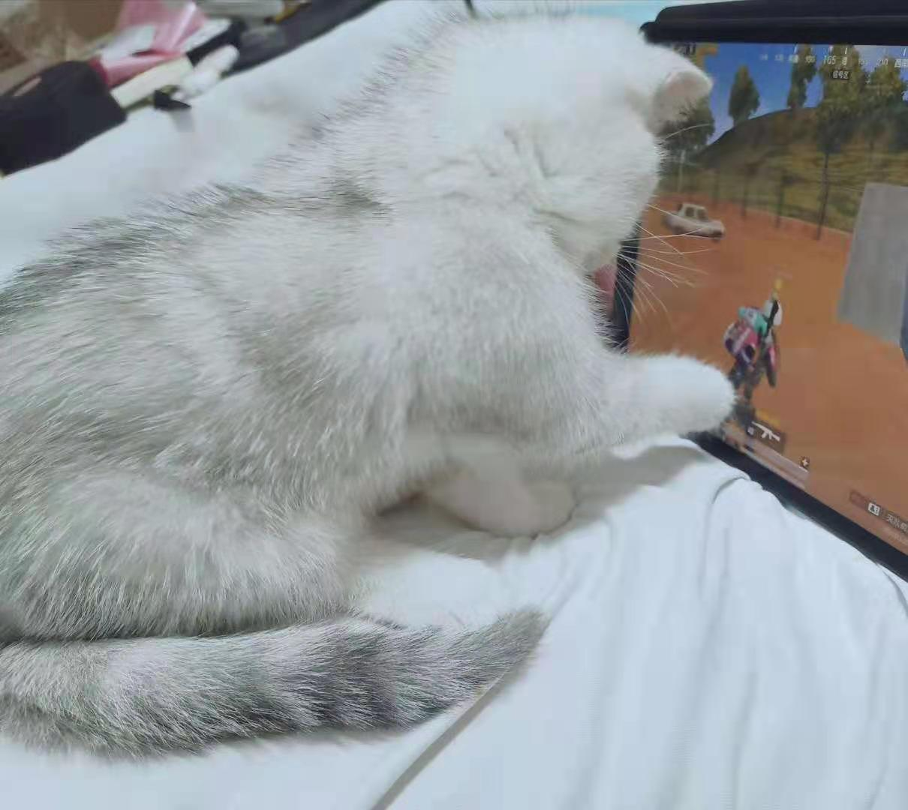
My pet

Slide 10
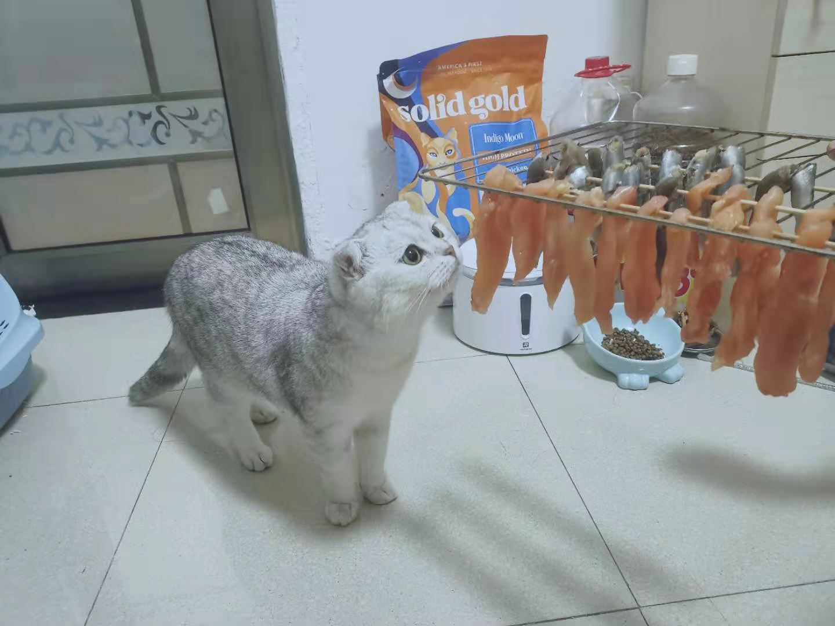
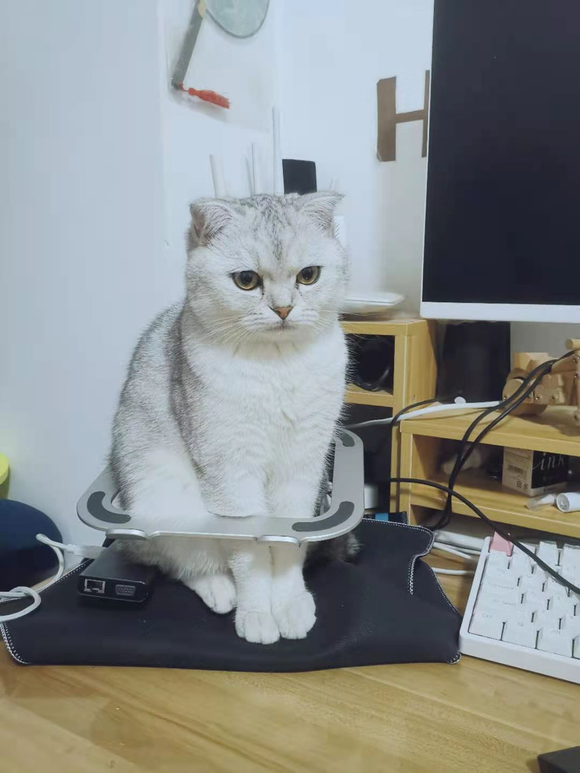
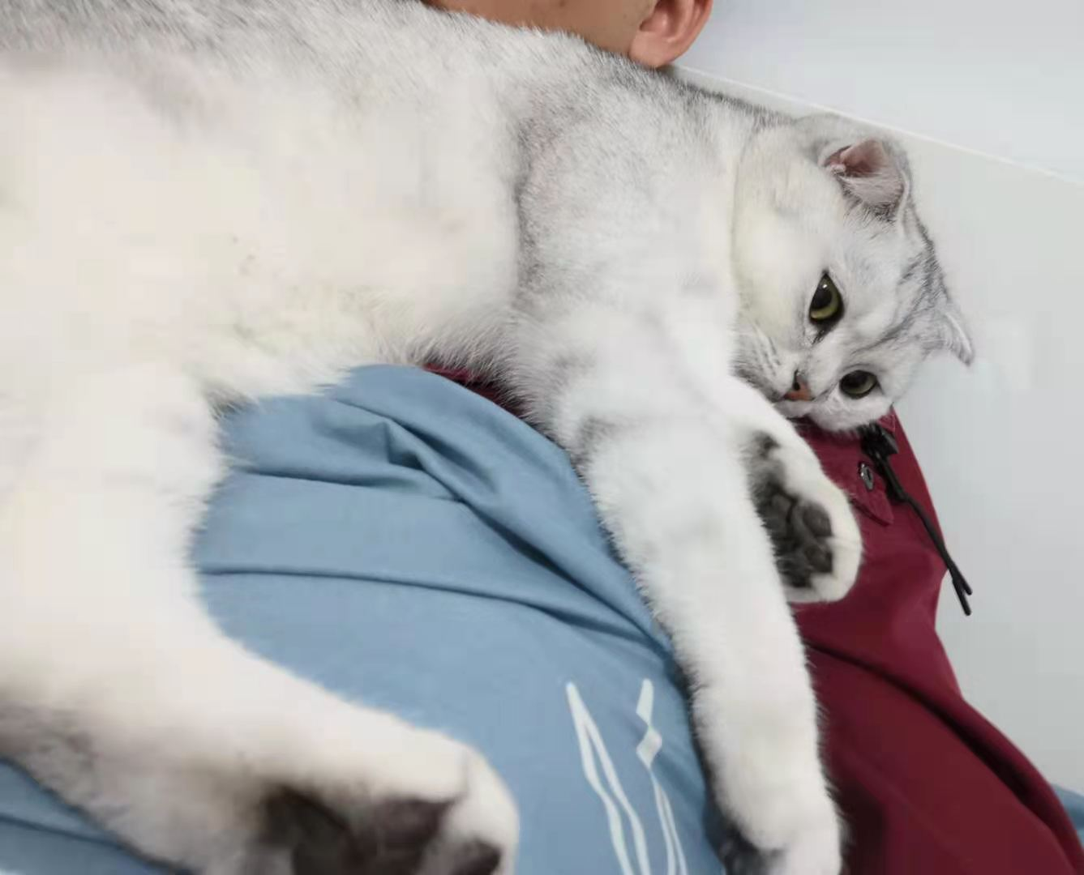
My pet

Slide 11
What pet do you like to keep ?
Question: What is my cat’s name？
Tips:
Feature: too much nonsense
Time: May 2020
Place: Washington
People: A man

Slide 12
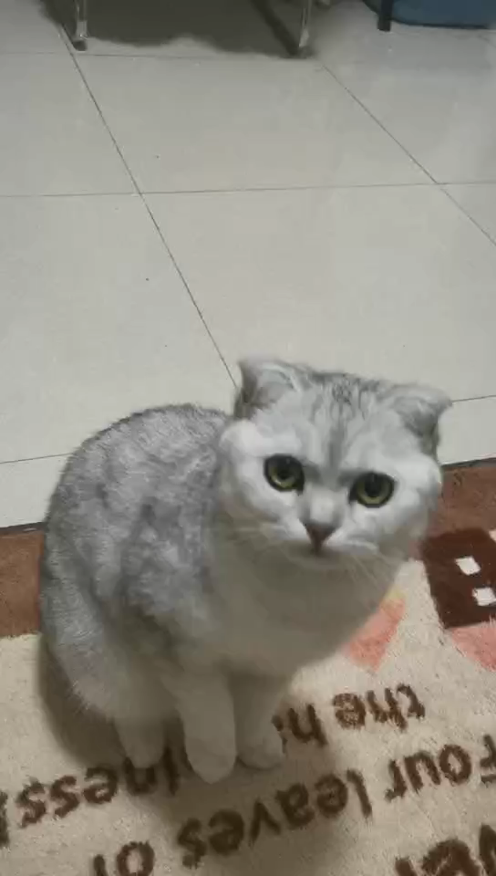
Training skill

Slide 13
Game party
/02

Slide 14
Game party
Who is the undercover game
Rules:
1. 5 people in the game
2. Among the 5 people present, 4 people got the same word,
and 1 person got another word related to it.
3. Each person uses one sentence per round to describe the words
they have received, not to let the undercover detect it, but also to
suggest to their companions
4. After each round of description, all the people vote to choose
who is suspected to be an undercover agent, and the person
with the most votes is out.
5. If undercover to the last round (when there are 2 people are left on the court)
the undercover wins

Slide 15
Q & A
/03

Slide 16
Thanks. And Your Slogan Here.

